Slide 1

Presentation for potential investors - 2013

Slide 2
What makes Head Biotech unique and what are we trying to solve?
What is Head Biotech’s approach?
Investment packages.

Slide 3
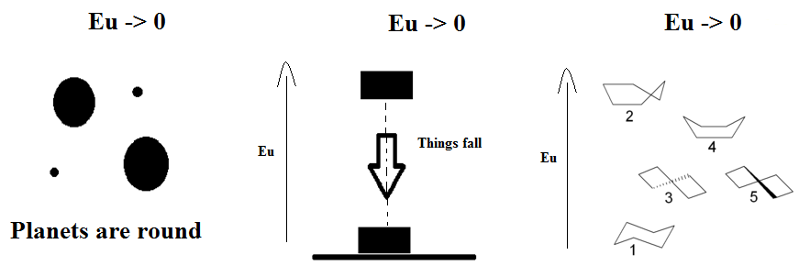
What makes Head Biotech unique?
Fact: Eu -> 0

Slide 4
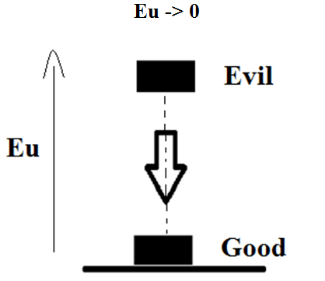


Head Biotech’s version of fourth law of thermodynamics states that the universe can feel the difference between evil and good in life – in the same way as with objects. Nash equilibrium describes it mathematically.
FALSE !
FACT !
PHILOSOPHY
We claim we can prove this energy pattern via Nash equilibrium and emperical data.

Slide 5
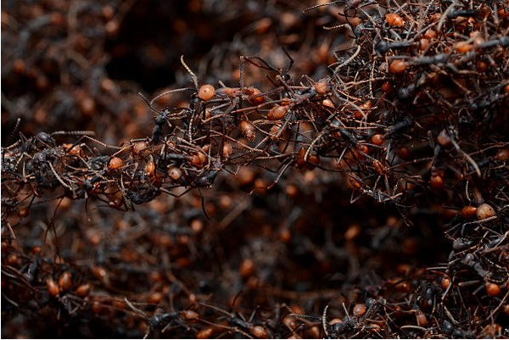
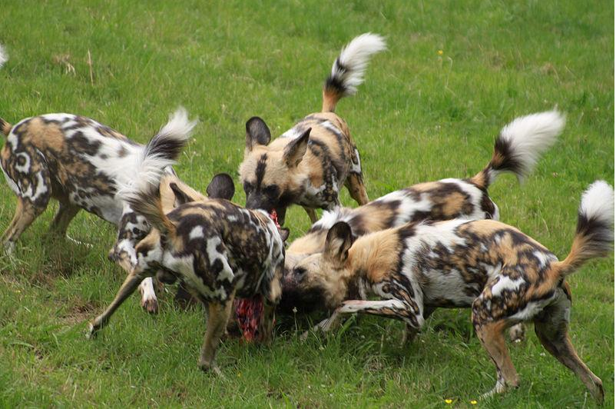
If it is true that the universe can feel differences in good and evil behavior, via energy states, then we should see it in nature. We can!
Emperical data: Solidarity/love wins over greed/hate during chaos, or free competition.

Slide 6

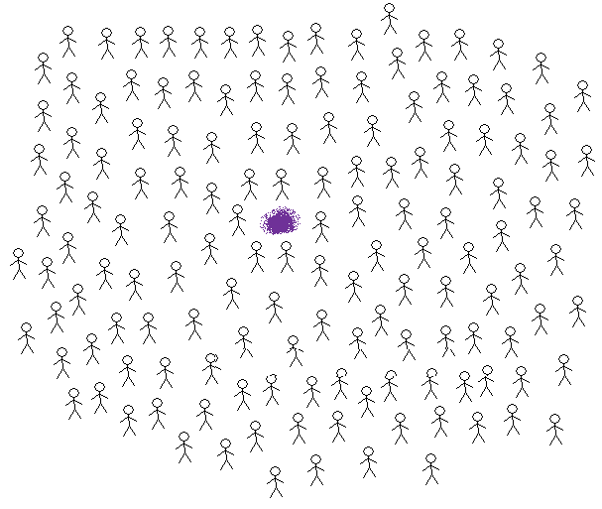
WARNING! THINGS HAVE CHANGED!
= Food/energy is scarce – on the whole.
1. NATURE HAS NEVER EXPERIENCED ANYTHING BUT FREE COMPETITION!
2. Eu -> 0 has NOT produced evil. Good has accumulated over evil during free competition for 4 billion years.
Eu -> 0 creates free competition! Has worked in evolution for about 4 billion years!

Slide 7
Governments experiences a CONSTANT incoming stream of energy/food. This is UNNATURAL and creates an energy-context that is the opposite to the universes will; Eu -> 0.
Establishment of governments = stiff systems.
Today
Possible to escape free competition.
Energy per individual in a population
Natural balance - FREE COMPETITION
TIME
First life-forms
Industrial revolution

Slide 8
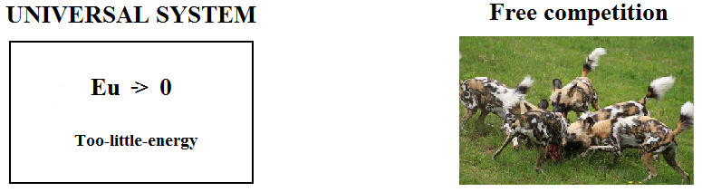
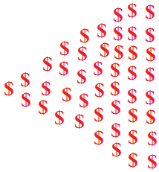
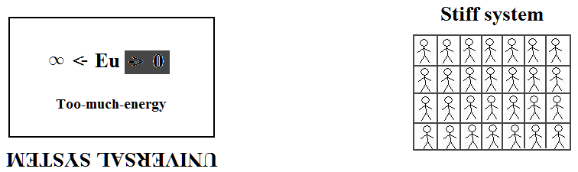
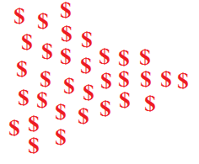
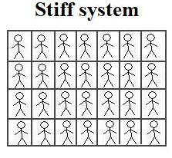
Head Biotech: Eu -> 0 hinders evil to accumulate over good. Evil accumulates over good in stiff systems, because Eu -> 0 is lost.
The way a stiff system gets its ”food” is unnatural.
Stiff system becomes a upside-down ”mini universe” Eu -> ∞ VS Eu -> 0
TAX MONEY/FOOD
TAX MONEY/FOOD
CONSTANT FLOW
OF ”FOOD”
CONSTANT FLOW
OF ”FOOD”
Makes possible..
CONSTANTLY: Too-much-food
Eu -> ∞
Eu -> ∞
DANGER!

Slide 9

Today a very small percentage of the worlds population lives inside a stiff system
For a stiff system to become ”natural” for the whole planets population, the planets population must be artifically reduced. To create a situation with constantly too-much-food.
Head Biotech will be a watch-dog, to make sure that this not happen.

Slide 10
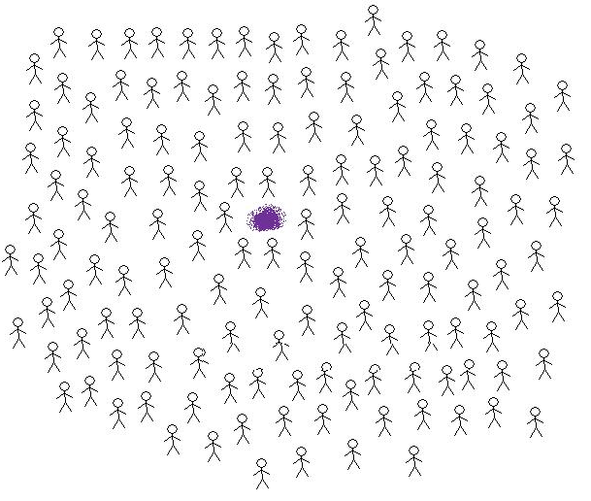
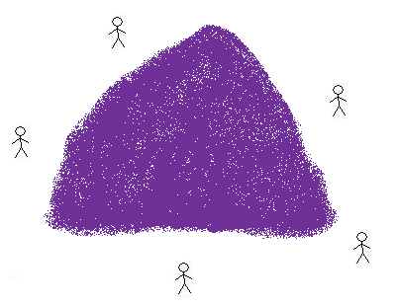
It’s all about politics. A pulling game between left and right wing.
ENERGY SITUATION IN A STIFF SYSTEM. POSITION NOT EARNED VIA FREE COMPETITION – BUT BY LAW.
Socialism can never win if the human population is allowed to spread naturally. They have the motive.
Solution: Make sure that the human population stays as high as possible. This will ensure free competition to be how power distributes in the future, as it has for 4 billion years. It will keep on filtering away evil, and the universe get its will.
Conservative. Lower taxes – fewer people in a too-much-energy context. Pro: free competition.
Socialism. Higher taxes – more people in a too-much-energy context. Pro: stiff systems.

Slide 11
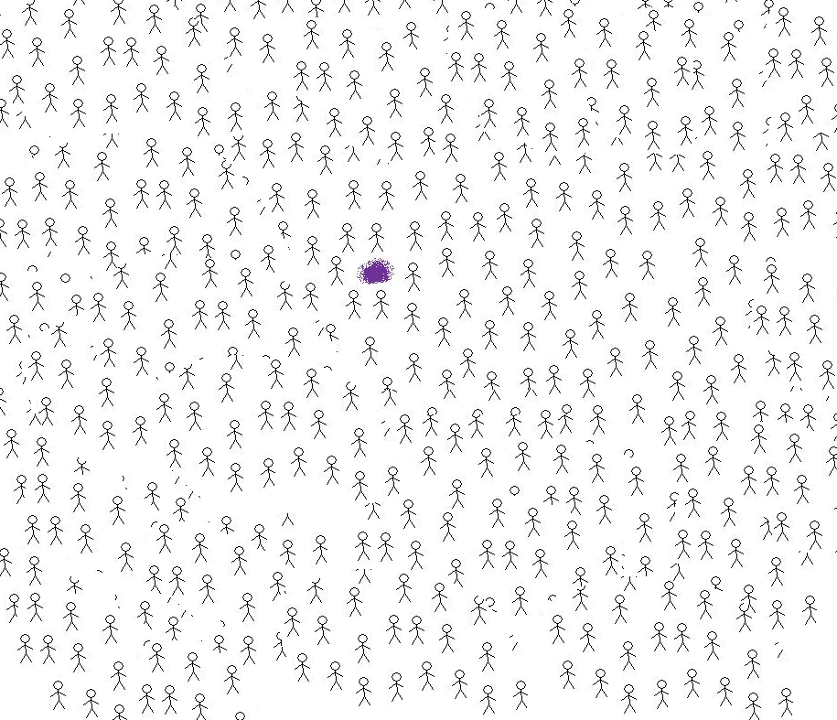
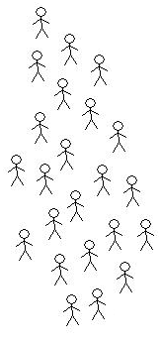
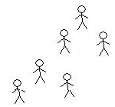

2. Head Biotech’s approach is to make sure that the worlds population can be as high as possible.
WE HAVE STOPPED STIFF SYSTEMS POSSIBLE TAKING OVER .
Head Biotech’s mission is to avoid this to happen. We will work to fill the planet with as many individuals as possible via research and feeding programs.
ACCUMULATION OF EVIL ON THIS PLANET HAS BEEN AVOIDED.
To make this energy context to become sustainable on the planet, it becomes necessarry to cut down on the natural population growth.

Slide 12
3. Investment packages.
1) Help Head Biotech to publish its version of fourth law of thermodynamics.
Cost: 5 – 10 000$
2) Establish one Head Biotech research office in India (Bjørn). In vitro meats.
Cost: 10 000$ per year.
3) Establish two offices, one in India (Bjørn and Varma) and one in Pakistan (Nasir). In vitro meats, Personalized medicine and drought-resistant crops. Cost: 30 000$ per year.

Slide 13
4) Ideal activity: Research and help work (feeding and study centers for poor people). Cost: 30 000$ per year and up..
Payback on investments:
1) Head Biotech’s main purpose is to work to make room for as many people as possible on the planet. However, our research activity can create income in the future. Any research brekthroughs can create income as for ordinary biotech companies.

Slide 14
Conclusion
Our main activity will be research on personalized medicine, in vitro meats and drought-resistant crops. To prepare the planet for more people.
Take universal responsibility. Make the planet a better place – by keeping it from developing in an evil direction via stiff systems.
Political watch-dog from our point of view. An alternative political oriented help organization.
Possible paybacks for investors: 1) Scientific breakthroughs/patents from our research work.

Slide 15

Questions to Head Biotech’s founder?
Bjørn Sponberg
M.Sc. Molecular Medicine
M.Sc. Bioinformatics

Slide 16
http://headbiotech.wordpress.com/

